Slide 1
Mediation in health research: A statistics workshop using SPSS
Dr. Sean P. Mackinnon
Dalhousie University
Crossroads Interdisciplinary Health Conference, 2015

Slide 2
What kinds of questions does mediation answer?
Mediation asks about the process by which a predictor variable affects an outcome
“Does X predict M, which in turn predicts Y?”
E.g., “Does exercise improve cardiovascular health, which in turn increases longevity?”

Slide 3
Linear Regression
Understanding mediation requires a basic understanding of linear regression
Displayed as a path diagram, it could look something like this:
The number depicted here is the slope (B value, or b₁ above)
Impulsivity
.30
Binge Drinking
c-path
also called the “total effect”

Slide 4
Mediation
Mediation builds on this basic linear regression model by adding a third variable (i.e., the “mediator”)
In mediation, the third variable is thought to come in between X & Y. So, X leads to the mediator, which in turn leads to Y.
Enhancement Motives
Impulsivity
Binge Drinking

Slide 5
Mediation
The idea is, the c-path (the direct effect) should get smaller with the addition of a mediator.
So, we want to know if the c-path – c’-path is “statistically significant.”
Enhancement Motives
Impulsivity
Binge Drinking
c’-path
Also called the “direct effect”

Slide 6
Mediation
To test this, you first need to get the slope of two other relationships: a and b paths
Get the slope of this relationship while also controlling for enhancement motives
b-path
Get the slope of this relationship
a-path
Enhancement Motives
Impulsivity
Binge Drinking
c’-path

Slide 7
Mediation
Mathematicians have shown that
(a-path * b-path) = c-path – c’ path
(But only when X and M are continuous)
Thus, if a*b (“the indirect effect”) is statistically significant, mediation has occurred
Enhancement Motives
a-path
b-path
Impulsivity
Binge Drinking
c’-path
Preacher & Hayes (2008)

Slide 8
Significance of Indirect Effect
Lots of ways to test the significance of a*b
Test of Joint Significance
Sobel Test
Bootstrapped Confidence Intervals
Of these methods, bootstrapping is currently the most preferred
But … Hayes & Scharkow (2013) have shown that the different methods agree > 90% of the time…

Slide 9
Joint Significance Test (Baron & Kenny, 1986)
If the a-path AND the b-path are both significant, conclude that a*b is also significant.
This is a liberal test (i.e., high Type I error) and is usually used as a supplement to other methods.
a-path
Enhancement Motives
b-path
.25*
.28*
Impulsivity
.05
Binge Drinking
c’ path

Slide 10
Sobel Test (Sobel, 1982)
An alternative is to estimate the indirect effect and its significance using the Sobel test (Sobel. 1982).
It is a conservative test (i.e., high Type II error)
z-value = a*b/SQRT(b²*s_{a}² + a²*s_{b}²)
a = B value (slope) for a-path
b = B value (slope) for b-path
s_{a} = SE for a-path
s_{a} = SE for b-path
Online Calculator for Sobel Test:
http://quantpsy.org/sobel/sobel.htm
Also available in the PROCESS macro discussed later

Slide 11
Bootstrapping
The sobel test is inaccurate because it relies on an assumption of a normal sampling distrbution:
However, the sampling distribution distribution of a*b is non-normal except in very large samples…
Bootstrapping is a computer intensive, robust analysis technique that can be applied to non-normal data.
Virtually any analysis can be bootstrapped, but we’re going to apply it to testing the significance of the indirect effect (a*b).

Slide 12
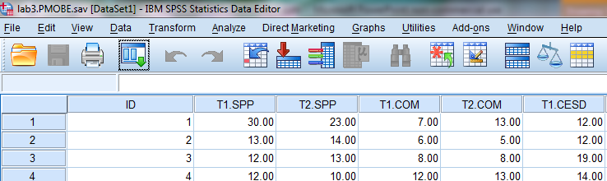
What is a “Re-Sample?”
In SPSS, Each row is a “person” who has an ID, and lots of values on measures
A “re-sample” randomly samples participants from the sample, with replacement
Re-sample 1
ID1
ID3
ID4
ID2
Re-sample 2
ID1
ID1
ID3
ID2
Re-sample 3
ID4
ID4
ID2
ID2
Note that people can be duplicated in the resamples using this method

Slide 13
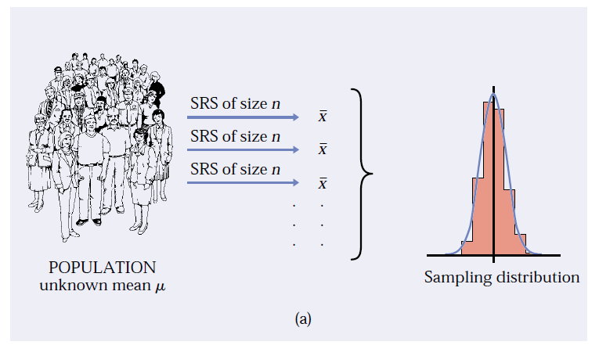
What is bootstrapping?
The idea of the sampling distribution of the sample mean x-bar: take very many samples, collect the x-values from each, and look at the distribution of these values
From Hesterberg et al. (2003)

Slide 14
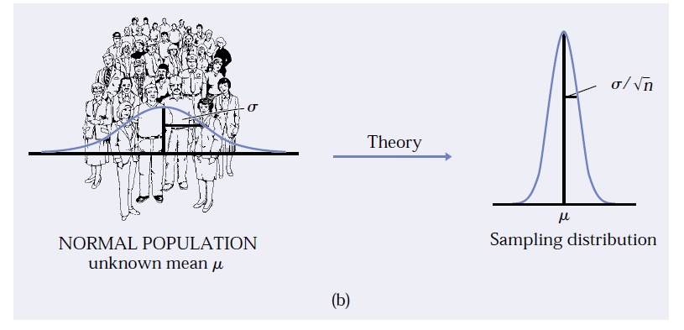
What is bootstrapping?
The theory shortcut: if we know that the population values follow a normal distribution, theory tells us that the sampling distribution of x-bar is also normal.
From Hesterberg et al. (2003)
This is known as the central limit theorem

Slide 15
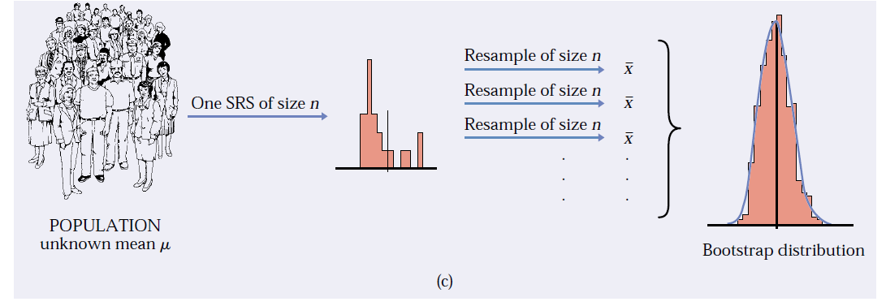
What is bootstrapping?
The bootstrap idea: when theory fails and we can afford only one sample, that sample stands in for the population, and
the distribution of x in many resamples stands in for the sampling distribution
From Hesterberg et al. (2003)

Slide 16
Bootstrapping Indirect Effects
Create 1000s of simulated datasets using re-sampling with replacement
Pretends as though your sample is the population, and you simulate other samples from that.
Run the analysis once in each of these 1000s of samples
Of those analyses, 95% of the generated statistics will fall between two numbers. If zero isn’t in that interval, p < .05!

Slide 17
Effect Sizes for Mediation
There are many different ways to calculate effect sizes for mediation analysis (Preacher & Kelly, 2011)
Two simple-to-understand effect size measures are:
Percent mediation (P_{M})
Completely Standardized Indirect Effect (ab_{cs})

Slide 18
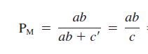
Percent Mediation
ab = .25 * .28 = .07
c = .12
P_{M} = .07 / .12 = .583
Interpreted as the percent of the total effect (c) accounted for by your indirect effect (a*b).
a-path
Enhancement Motives
b-path
.25*
.28*
Impulsivity
.12* (.05)
Binge Drinking
c-path (c’ path)

Slide 19
Note about Percent Mediation…
The direct effect (c’-path) can sometimes be larger than the total effect (c-path)
Inconsistent mediation
In these cases, take the absolute value of c’ before calculating effect size to avoid proportions greater than 1.0.

Slide 20
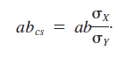
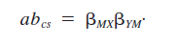
Completely Standardized Indirect Effect
Which is the same as …
So, it’s just two steps:
1. Calculate the standardized regression paths for the a and b paths
2. Multiply them together to get the ES
(So, just standardize your variables before analysis and you can get a 95% CI!)
Is now a standardized version that will be similar in interpretation across measures … but it’s no longer bounded by -1 and 1 like a correlation.

Slide 21
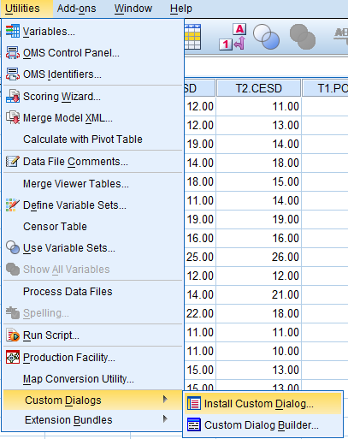
Installing the PROCESS macro in SPSS
Download files from here:
process.spd
http://www.processmacro.org/download.html
Once you do this, you’ll get a new analysis you can run under:
Analyze → Regression → PROCESS
Now every time you open SPSS, you’ll have the option to run mediation analyses!

Slide 22
A Sample Model w. Output
Health-Related Behaviours
Conscientious Personality
Overall Physical Health
RQ: Do health related behaviours mediate the relationship between conscientious personality and overall physical health?
Uses a (fabricated) dataset you can find online here if you want to try it on your own time for practice:
http://savvystatistics.com/wp-content/uploads/2015/03/crossroads.2015.data_.csv

Slide 23
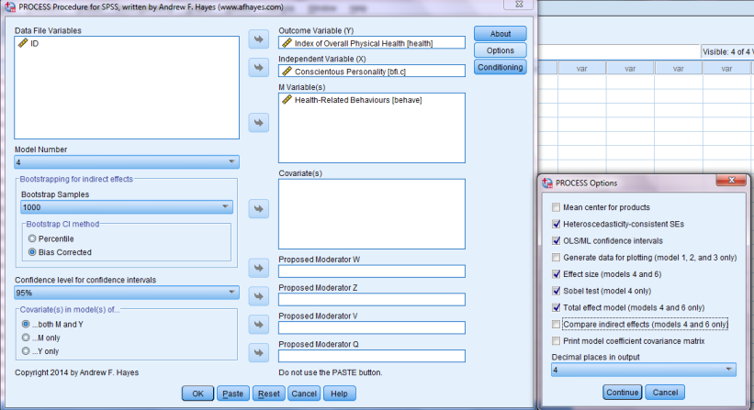
How to Run in SPSS
For basic mediation, use “model 4”
Conscientiousness = X
Physical health = Y
Health-Related Behaviours = M

Slide 24
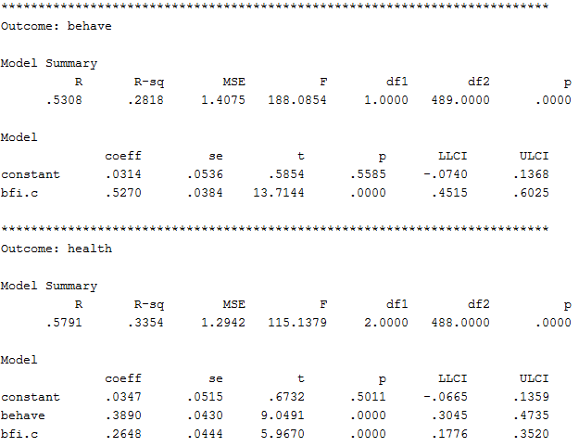
Annotated Output: a, b. c’ paths
a-path
b-path
c'-path (direct effect)
Coeff = Slope; SE = standard error; t = t-statistic; p = p-value
LLCI & ULCI = lower and upper levels for confidence interval

Slide 25
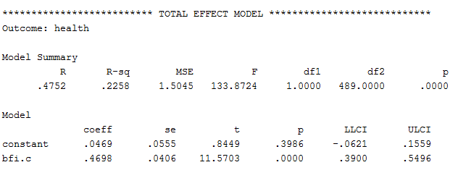
Annotated Output: c-path
c-path
(total effect)

Slide 26
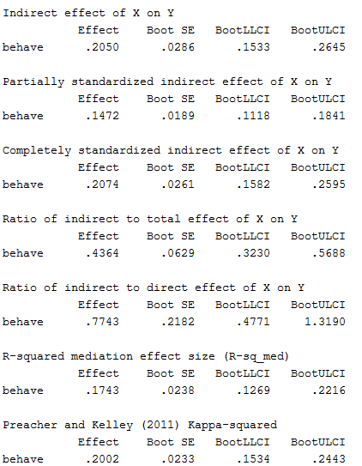
Annotated Output: Effect Size & Significance of Indirect Effect
a*b or “indirect effect”
Report the 95% CI for this
If the CI for a*b does not include zero, then mediation has occurred!
Effect Size 1: ab_{cs}
(Report the 95% CI For this)
Effect Size 2: P_{M}
(Don’t use the 95% CI For this)
Upper and Lower
Bootstrapped 95% CI

Slide 27
Reporting Mediation Analysis
Health-Related Behaviours
0.52***
0.39***
Conscientious Personality
Overall Physical Health
0.26***
(0.47)***
There was a significant indirect effect of conscientiousness on overall physical health through health-related behaviours, ab = 0.21, BCa CI [0.15, 0.26]. The mediator could account for roughly half of the total effect, P_{M} = .44.

Slide 28
Questions / Contact
Thank you for your time! ☺
Email: mackinnon.sean@dal.ca

Slide 29
Appendix: Syntax
*Make sure to run the process.sps macro first, or this won’t work!
*This is an alternative to running using the GUI
PROCESS vars = health bfi.c behave
/y=health/x=bfi.c/m=behave/w=/z=/v=/q=/
model =4/boot=1000/center=0/hc3=1/effsize=1/
normal=1/coeffci=1/conf=95/percent=0/total=1/
covmy=0/jn=0/quantile =0/plot=0/contrast=0/
decimals=F10.4/covcoeff=0.

